Slide 1
Key health issues in Southampton (and Wessex)
Dr Andrew Mortimore

Slide 2
A bit of context
A backward glance
Five challenges
A forward look

Slide 3
A Plea to Stop Reorganising
...[T]he leaders of the NHS and government have sorted and resorted local, regional and national structures into a continual parade of new aggregates and agencies. Each change made sense, but the parade doesn’t make sense. It drains energy and confidence from the workforce....[T]he time has come for stability, on the basis of which, paradoxically, productive change becomes easier and faster for the good, smart, committed people of the NHS.
Don Berwick (2008)

Slide 5
New public health system for England
Secretary of State
Public Health England
NHS Commissioning Board
Local Authorities
Clinical Commissioning Groups
Health and Wellbeing Boards

Slide 6
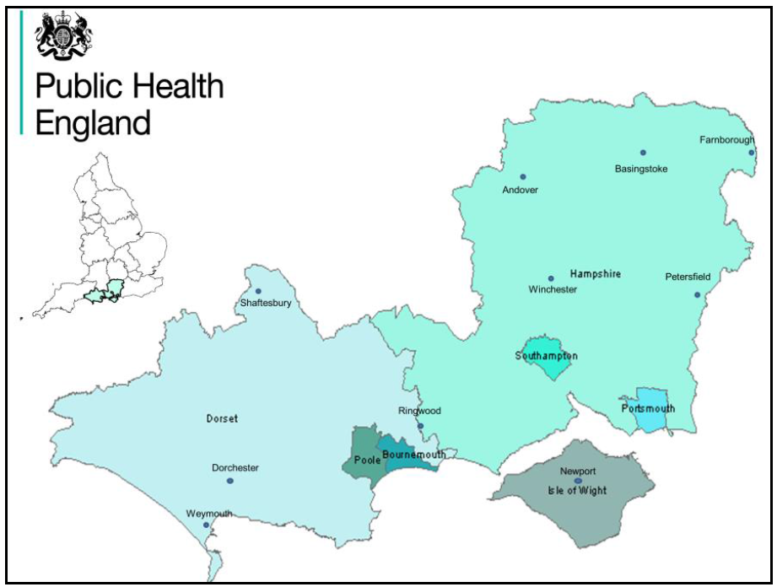

Slide 7
The only way is Wessex
a population of 2.7 million people
local authorities: two county, five unitary and 22 district/borough
six health and wellbeing boards
nine clinical commissioning groups
two local resilience forums
four strategic clinical networks
one local education and training board
one academic health science network
public health teams in universities

Slide 8


Slide 9
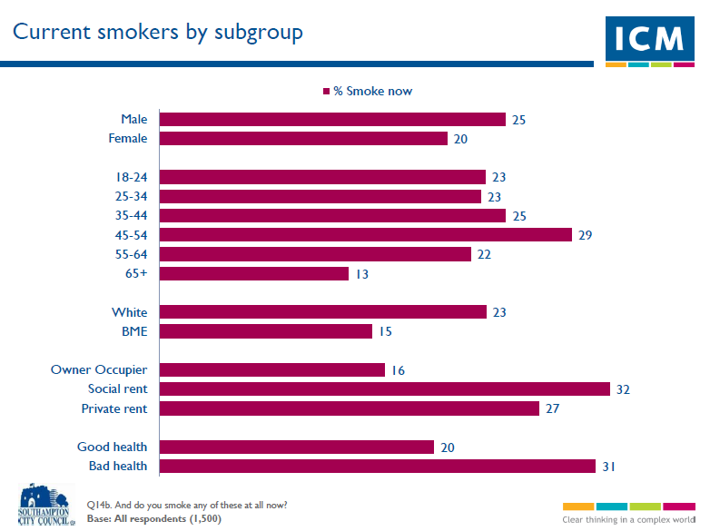

Slide 10
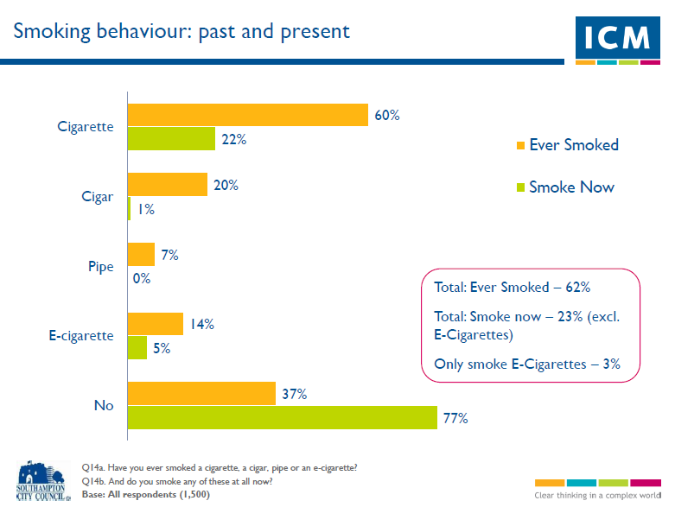

Slide 11
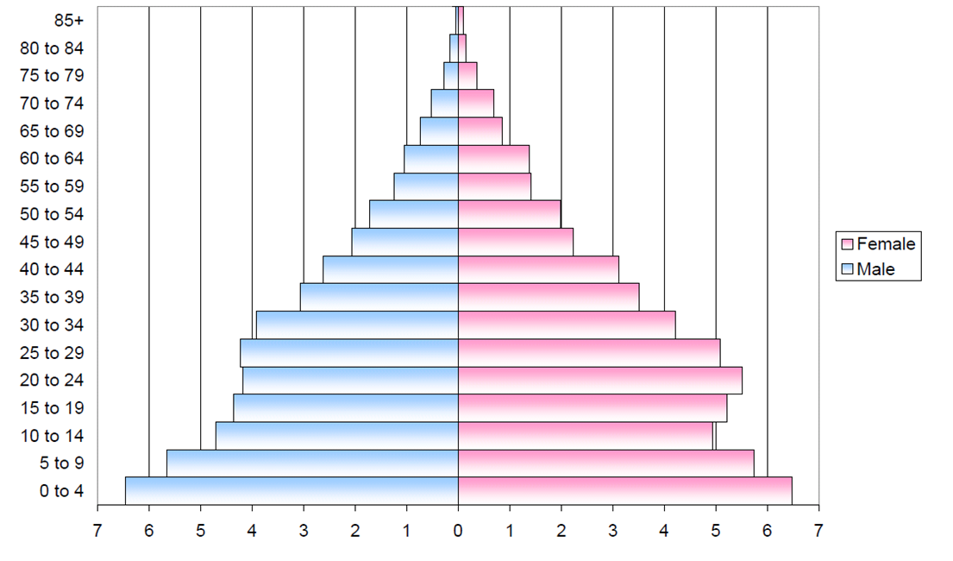
Changes in Southampton’s population over time….
Southampton Population 1851
Notes:
11
In 1851 Southampton had a population of around 45,000 and its age profile was a true pyramid. Over time the population here (as nationally) has aged with fertility rates falling and life expectancy improving. In 1851 life expectancy for males was only about 40 years.
By 1931 the population had grown to 180,000 and average household size was 3.87. In the 2011 Census average household size was 2.3 in the city.

Slide 12
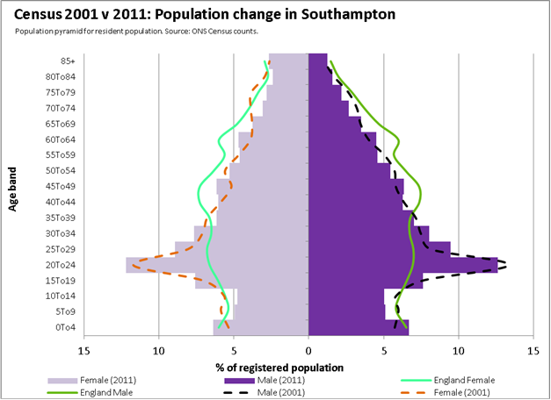
Changes in Southampton’s population over time….
Southampton Population 2011
Notes:
12
Solid blocks are Southampton in 2011
Dotted line is the profile in 2001.
(Green line is England)

Slide 13
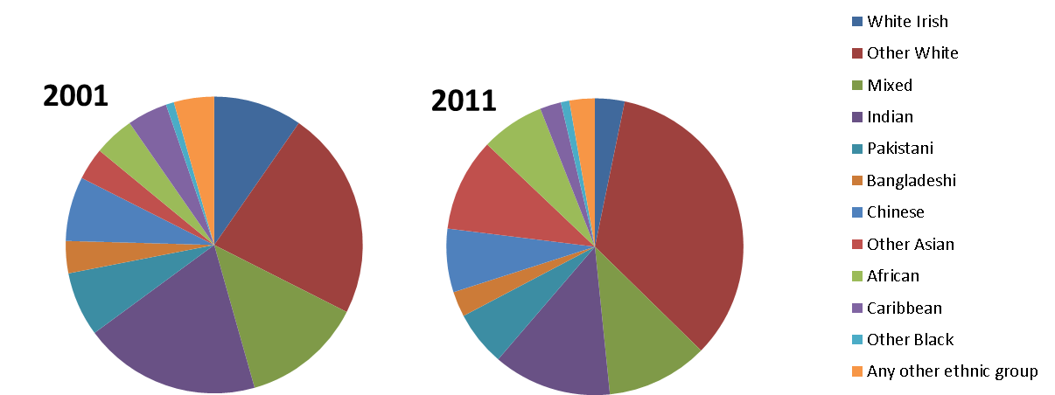
Changes in Southampton’s population over time….ethnicity
77.7% of residents recorded as white British (compared to 88.7% in 2001)
‘Other white’ population (which includes migrants from Europe) has increased in last 10 years by over 200% (from 5,519 to 17,461)
Largest % increase in ‘other Asian’ population (833 people in 2001 to 5,281 in 2011)
Notes:
13

Slide 14
Improvements over the past decade…
Compared with 10 years ago, men are 19% and women are 3% more likely to live to the age of 75 (the probability of survival to age 75 in 1997-99 was 56% for males and 74% for females, in 2007-09 the figures were 67% and 77% respectively)
Compared with 10 years ago, male life expectancy is four years longer and women’s life expectancy is two years longer
Death rates have fallen by 22% (342 fewer deaths each year in the city)
Deaths from heart disease have fallen by 49% (202 per year fewer)
Deaths from stroke are 38% lower
Cancer death rate has fallen by 9%

Slide 15
Smoking prevalence is estimated to have fallen from 32% to 22% over the past decade
Since 2003/04 smoking in pregnancy has reduced from 25.1% to 19.5% whilst breastfeeding rates have increased from 69.6% to 74.5%
Every day now an average of 15 eligible women are screened for breast cancer, 25 for cervical cancer and a further 23 eligible adults screened for bowel cancer
Educational attainment has improved – in 2005 34.6% of Southampton pupils gained 5 or more GCSEs at grades A*-C (including English and Maths), and by 2013 this had increased to 58.9%

Slide 16
Challenges
Men from the most deprived areas of Southampton have a life expectancy eight years less than men from the least deprived areas
In Southampton there is one teenage conception every two days
Every day a Southampton resident dies from a cause related to smoking
Every day in Southampton an average of three people are newly diagnosed with cancer
Gross annual pay for full-time workers in Southampton was just over £23,000 on average in 2010, compared with a national average of over £26,000
Every 13 hours there is a net gain of one additional person to Southampton GPs’ diabetic risk registers
Only 31.7% of adults access NHS dentistry with extra provision being under-used.

Slide 17
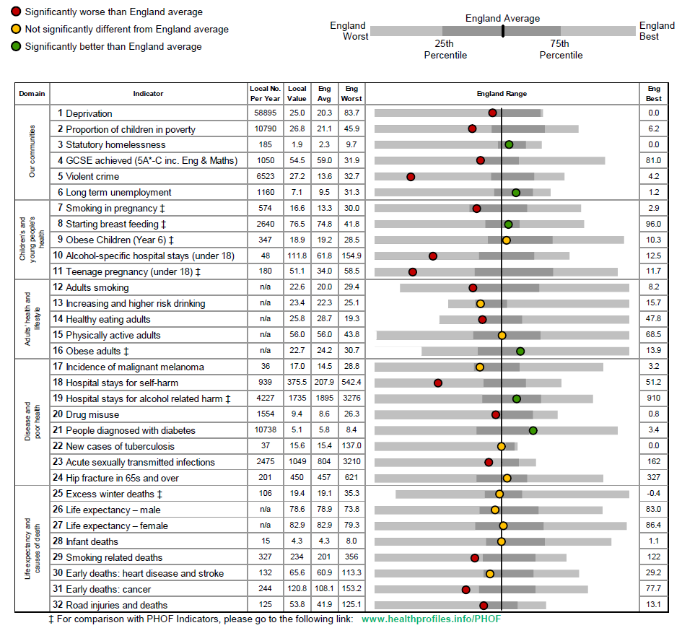
Southampton

Slide 18
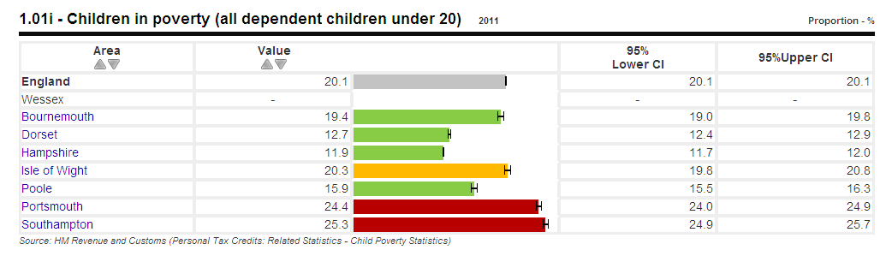
Children living in poverty

Slide 19
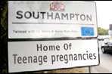

Slide 20
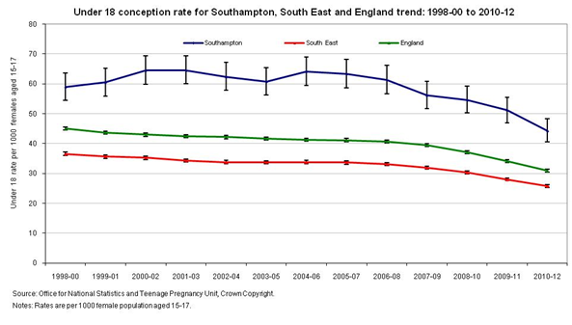

Slide 21
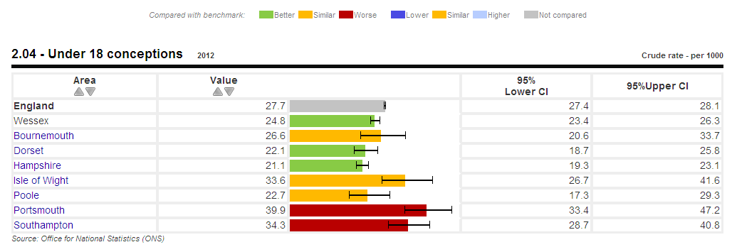
Teenage conception rates across Wessex LAs

Slide 22
SHIP Population Change by Age: 2011-2021
Notes:
Population and birth data taken from ONS projections
22

Slide 23
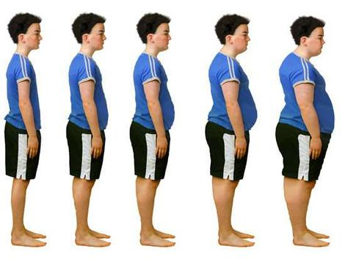

Slide 24
Trend in the proportion of Southampton children classified as obese by age group

Slide 25
A weighty problem
Children who were overweight at Year R tend to still be so at Year 6
20% of children who are a healthy weight at Year R have become overweight or obese by Year 6

Slide 26
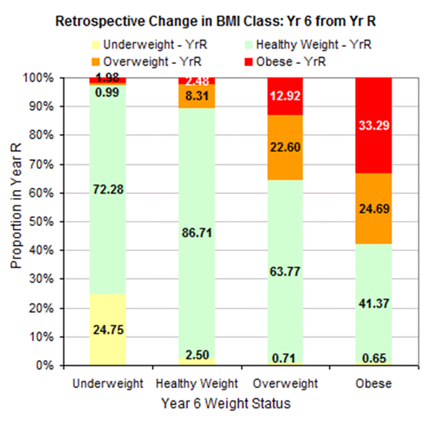
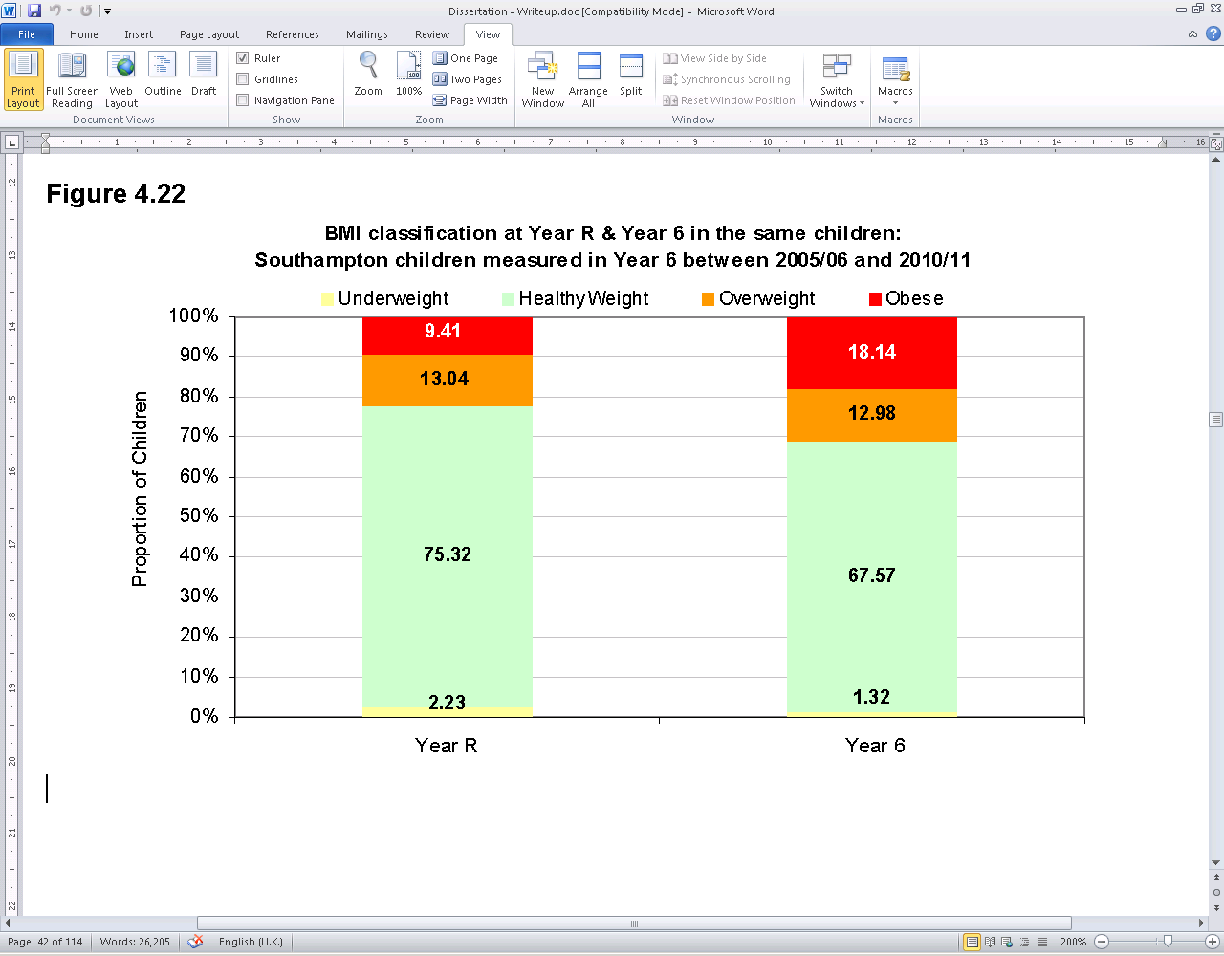
Change in BMI classification between Year R and Year 6 in the same children

Slide 27
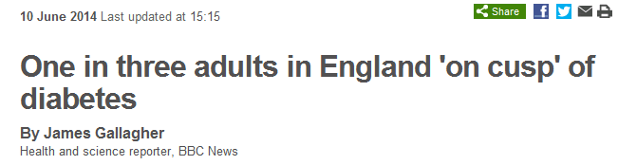

Slide 28
Challenge 1
  Nanny or nudge?

Slide 29
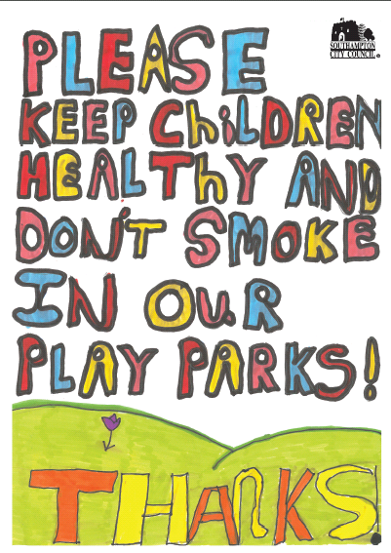

Slide 30
Fit for life
Being active
Eating well
A healthy weight

Slide 31


LIFELAB SOUTHAMPTON
Hospital-based classroom
Hands-on practical activities
+ pre and post school-based lessons
31

Slide 32
Challenge 2
  Universal v targeted

Slide 33
A tale of two cities?

Slide 34

A vibrant city…..

Slide 35
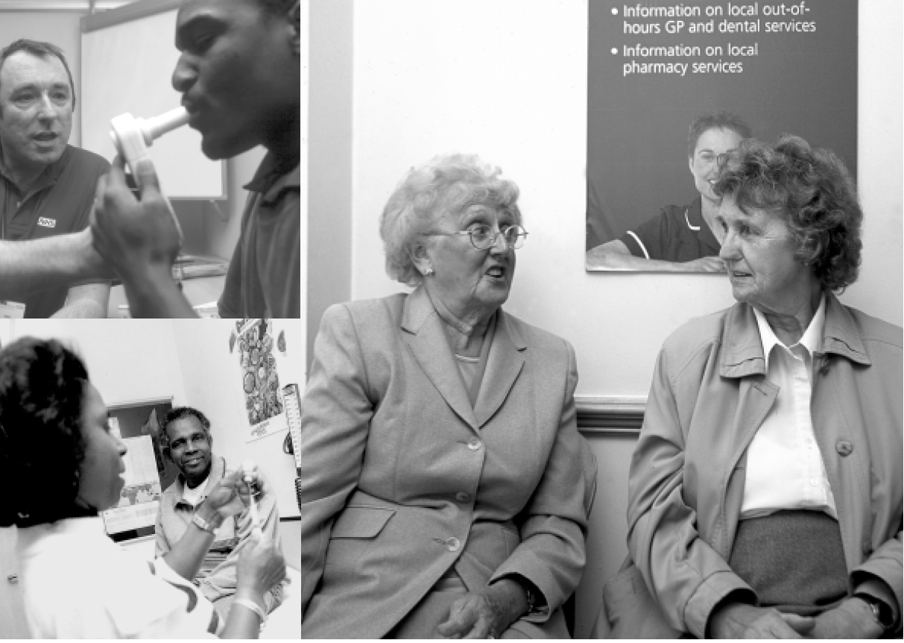
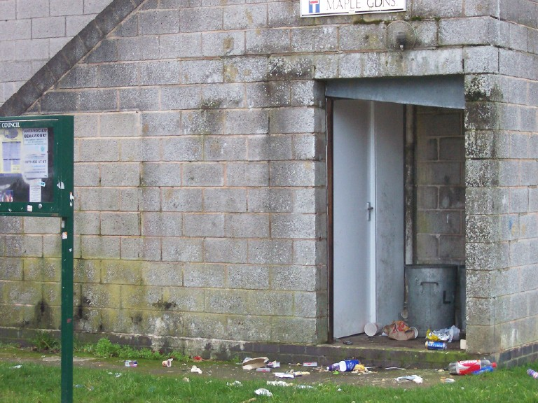
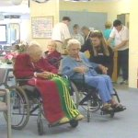
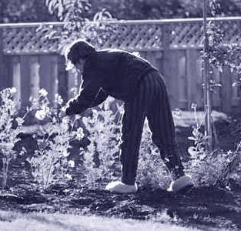
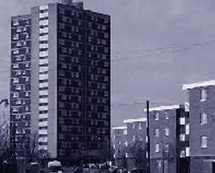
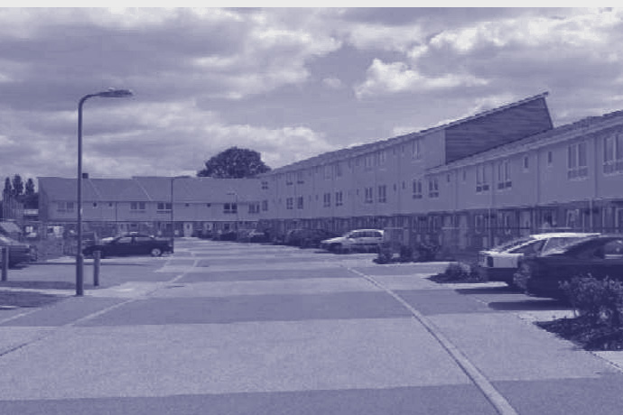
….with Challenges
3

Slide 36
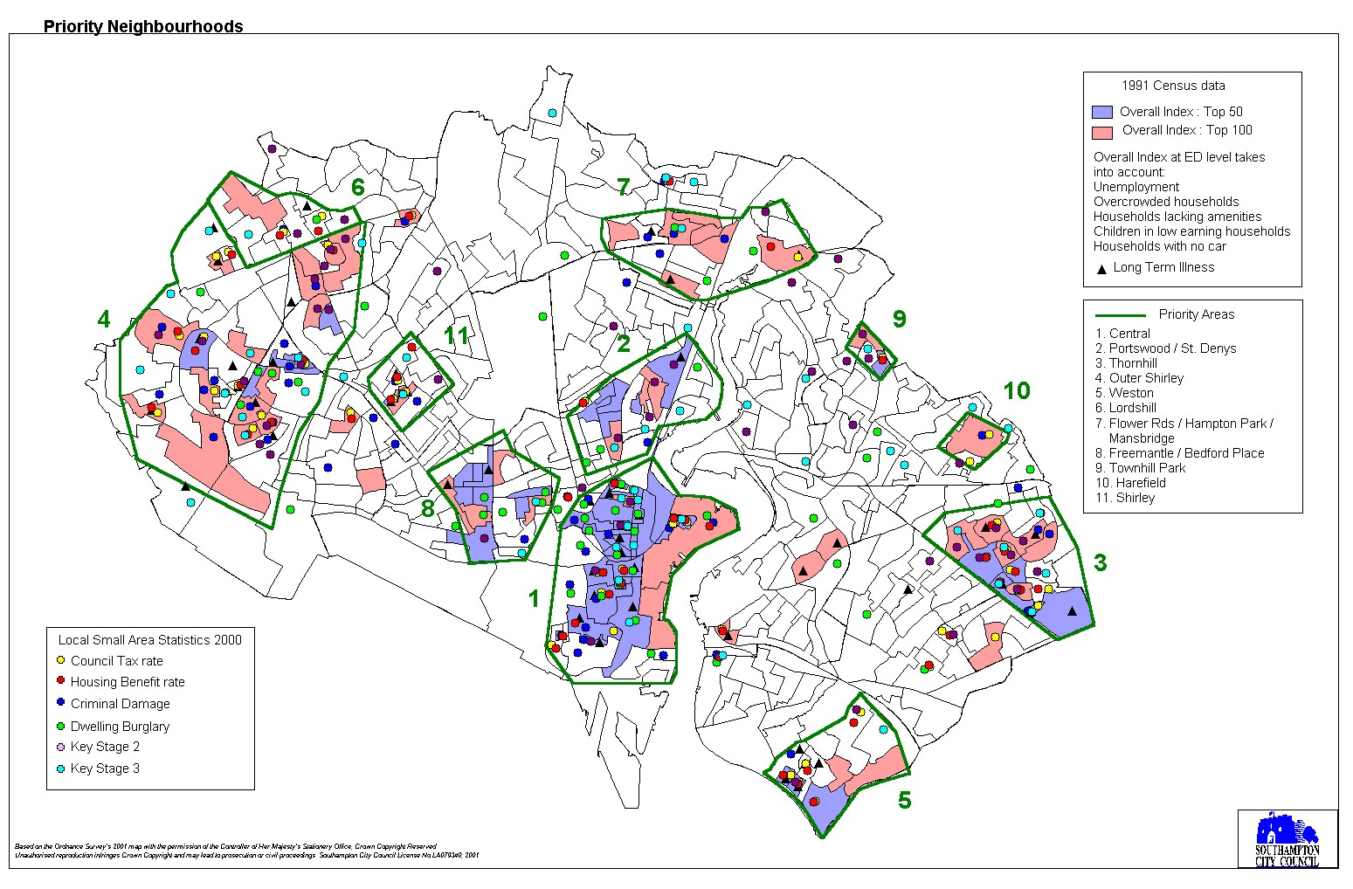

Slide 37
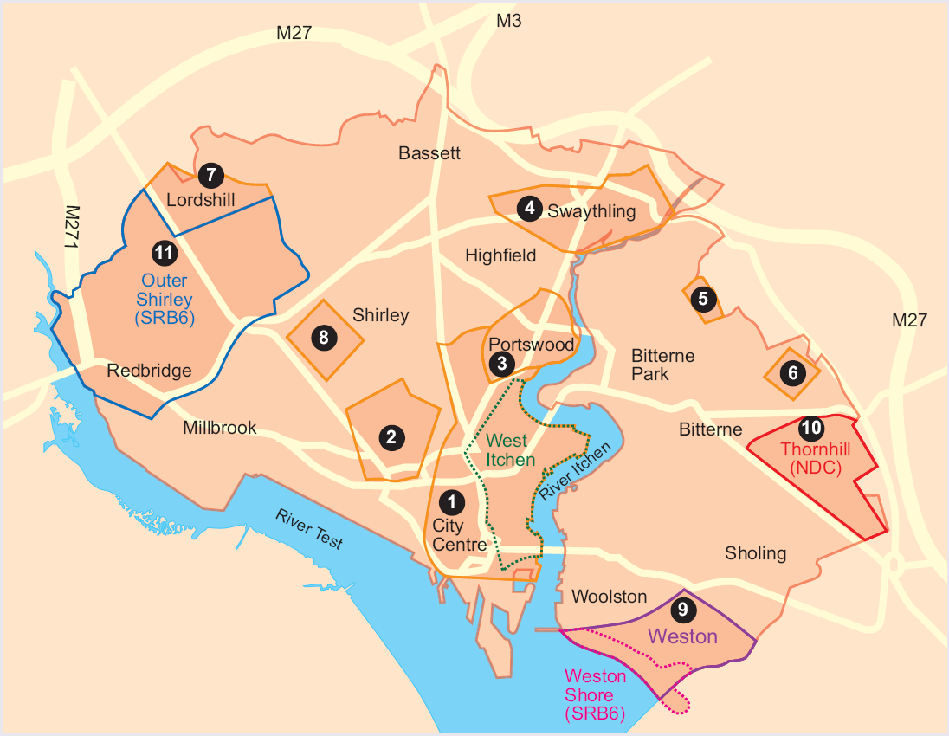

Slide 38
Challenges

Slide 39
Priority areas v the rest
Life expectancy is lower – 3.4 years for men, 2.7 years for women
Overall mortality rate is 28% higher
Premature (under 75) deaths are 58% higher
The death rate from circulatory disease in people under 75 is 56% higher
Severe mental illness is more common
Teenage pregnancy rates are higher
Low birth-weight is 32% more frequent
Smoking in pregnancy is over twice as common
Breast feeding is less common – 21% v 39%

Slide 40
Is the gap reducing?
Life expectancy 
Overall mortality rates 
Premature (under 75) deaths 
Under 75 deaths from circulatory disease 
Severe mental illness ?
Teenage pregnancy rates 
Low birth-weight 
Smoking in pregnancy 
Breast feeding 
Dental health – 5 year-olds 

Slide 41
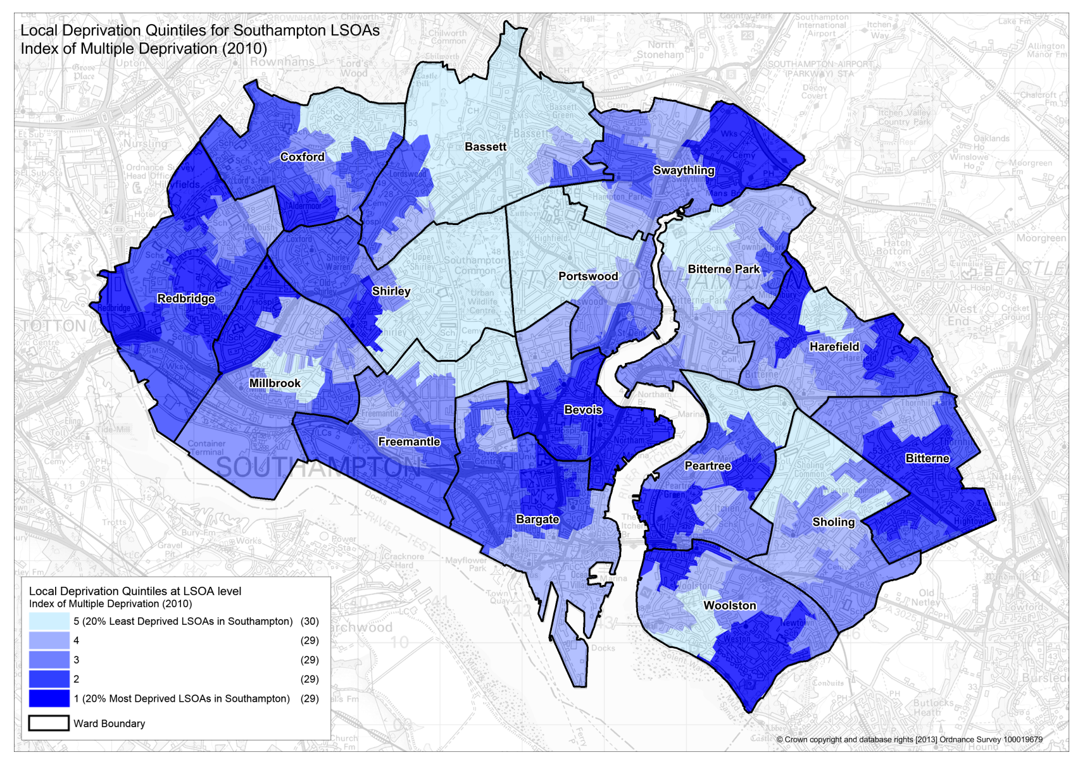
Inequalities – gap between most and least deprived quintile

Slide 42
Inequalities – gap between most and least deprived quintile

Slide 43
Challenge 3
  Pragmatism v perfectionism

Slide 44

Improving the public’s health – a resource for local authorities. D Buck and S Gregory. Kings Fund. December 2013

Slide 45
Return on investment (ROI)
For every £1 spent on sexual health services to prevent teenage pregnancy, there is a net saving of £11
Every new teenage mothers costs £100,000 over the next 5 years, including £15K per year in housing-related costs
Family Nurse Partnerships have generated savings of more than five time the programme costs
Targeted parenting programmes to prevent conduct disorders pay back £8 over six years for every £1 invested (savings to NHS, education and criminal justice system)
Good social and emotional health outcomes through investment in good education provide returns of up to £7 for every £1 invested

Slide 46
For every £1 spent on alcohol treatment £4 is saved in other public sector costs
Employee wellness programmes return £2 - £10 for every £1 spent
Improving air quality – the overall benefit-cost return can be over £600 for every £100 spent (eg Kensington and Chelsea)
Investment in falls prevention and bone health saves £5 for every £2 spent, through saving lives and maintaining independence
For £1 spent on smoking cessation and tobacco control measures, £5 are saved over a five year period
For £1 spent on measures to reduce obesity, there is a net saving of £2 over five years

Slide 47
Challenge 4
  Deficit model v asset-based approach

Slide 48
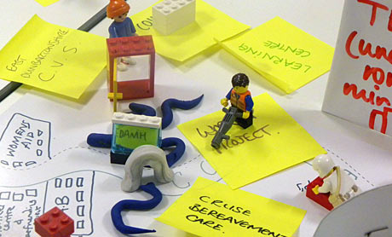
Eg loneliness / social isolation

Slide 49

Better Care
(draft)
It’s no longer a question about whether you use social media, but how well you do it.

Slide 50
Challenge 5
  The tyranny of the present v playing the long game

Slide 51
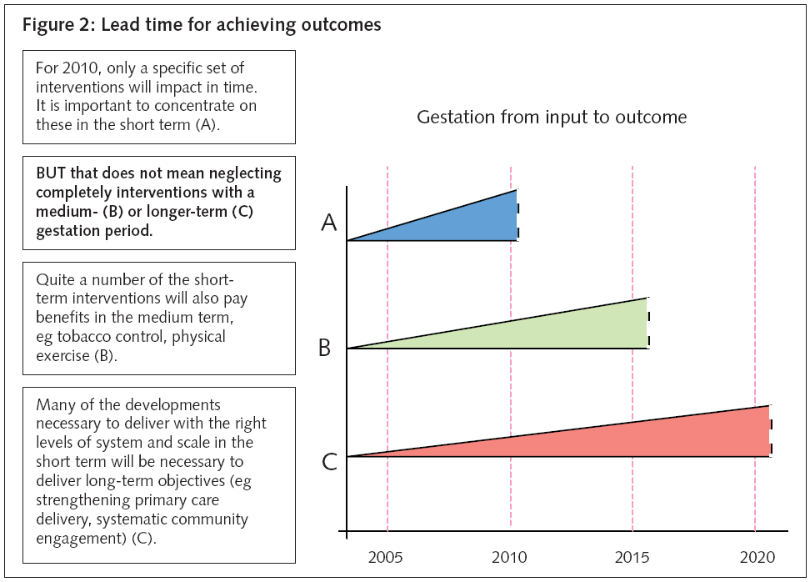

Slide 52
A forward look

Slide 53
Our world in 2025
(Courtesy Geoff Glover)
World population reaches 8.1 billion
Over 60% live in Asia
97% of population growth in the developing world
5 billion people live in cities
3 billion people lack water access
EU accounts for only 6.5% of world population
30% of EU population over 65
Asia becomes first producer and exporter globally
34% of worlds wealth - developing countries( 20% in 2005)
India and China 20% of worlds R and D(10% in 2010)
Global middle-class reaches 1 billion- 90% in developing countries
"Brain drain" becomes "brains circulation"!

Slide 54
Nanny v nudge
Universal v targeted
Pragmatism v perfectionism
Deficit model v asset-based approach
The tyranny of the present v playing the long game
Welcome to our world of public health – science and art!

Slide 55
www.publichealth.southampton.gov.uk
andrew.mortimore@southampton.gov.uk

